Slide 1
Football Predictions Program
Data Science Final Project
Ido Ashkenazi
Daniel Bugdari

Slide 2
The stages of ML
Data Collection
Data Visualization
Model Deployment
Web crawling for collecting and obtaining the data
Visualizing and understanding the data
Final predict model, making predictions using the model based on the relevant data
Problem Definition
Data Preparation
ML Modeling & Feature Engineering
Defining and understanding the problem we are looking to solve
Data validation, cleansing, filtering and formatting
Finding patterns in data, ML algorithms for data analysis and predictive modeling based on the provided data

Slide 3
Stages Map
Model Deployment
06
ML Modeling
05
Data Visualization
04
Data Preparation
03
Data Collection
02
Problem Definition
01
You Are Here

Slide 4

Problem Definition
Let’s start with a little practice.
Every month, your workplace chooses a bonding social game to play and the chosen game for the current month is a football matches predictions.
In this game, each week, one football match will be chosen and the employees will be asked to predict how it will end. Employees that correctly predict will receive a bonus of 500ILS. This week's match is between Maccabi Haifa and Hapoel Hadera.
Now I'd like to ask you: what is your prediction?
Almost certainly you will bet on Maccabi Haifa to win.
But why? What motivates you to bet on Maccabi Haifa's victory?
Is it possible to build an automatic machine that predicts match results based on the same features you used?

Slide 5
Stages Map
Model Deployment
06
ML Modeling
05
Data Visualization
04
Data Preparation
03
You Are Here
Data Collection
02
Problem Definition
01

Slide 6
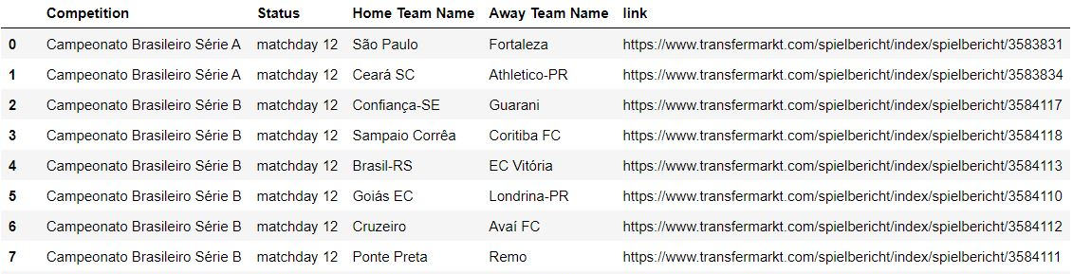

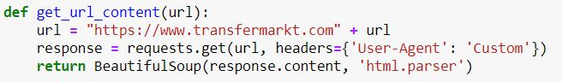
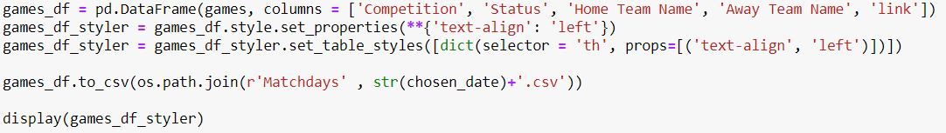
Data Collection – Web Crawling
Data Source:
www.transfermarkt.com
We used ‘BeautifulSoup’ Python library for pulling data out of the HTML pages and ‘Pandas’ library for data analysis and manipulation.

Slide 7
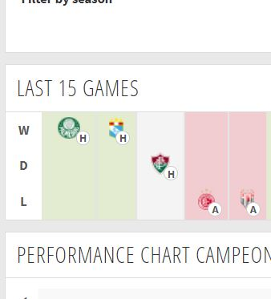
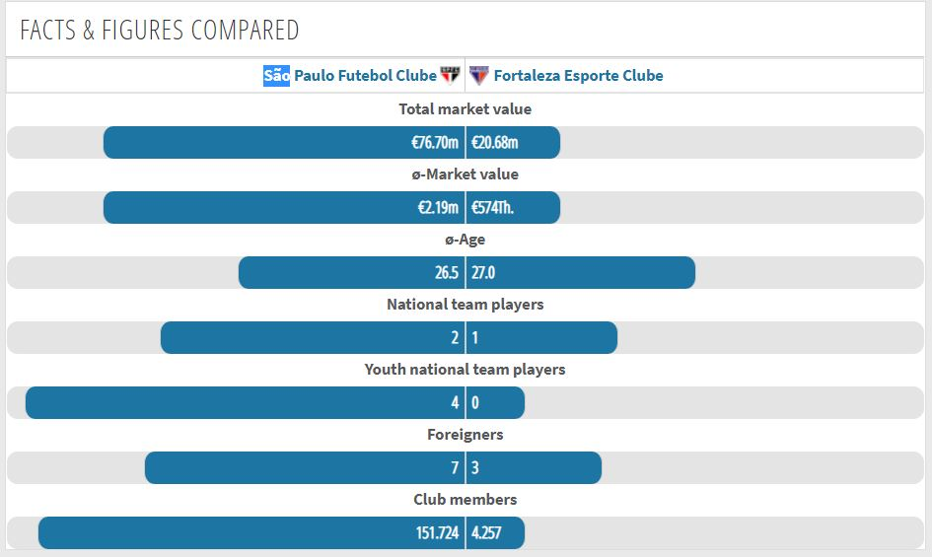
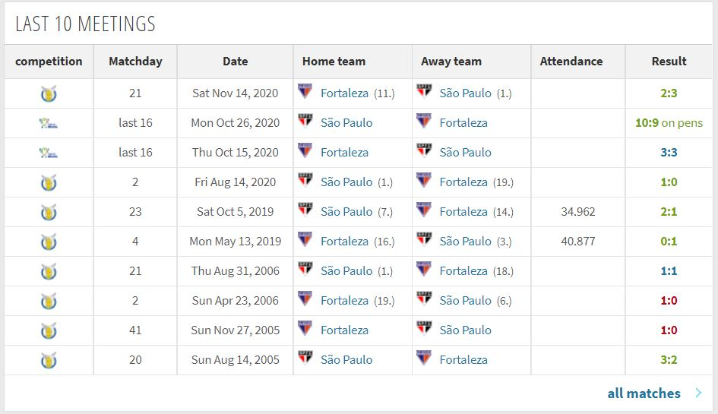
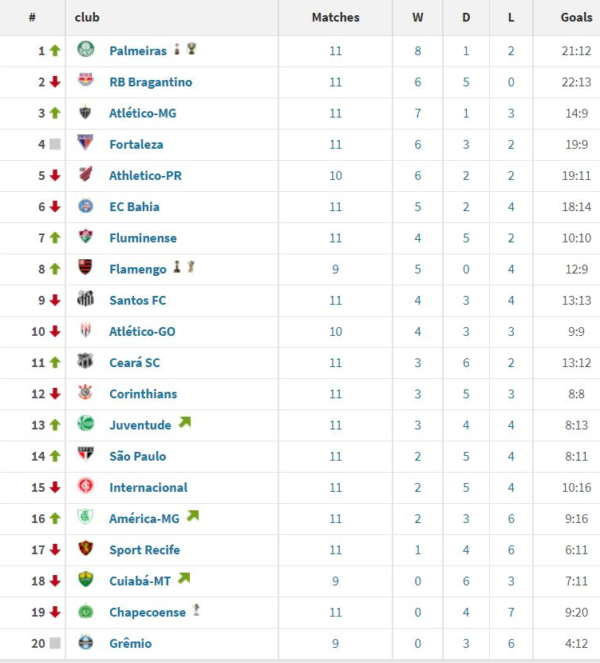
Data Collection – Web Crawling
Recent matches results
Players Strengths
Past meetings results
Positions
Getting the results of each team's recent matches
Getting the market values of the teams
Bigger market value = better players
Getting the results of their previous meetings
Getting the teams positions from the league table

Slide 8
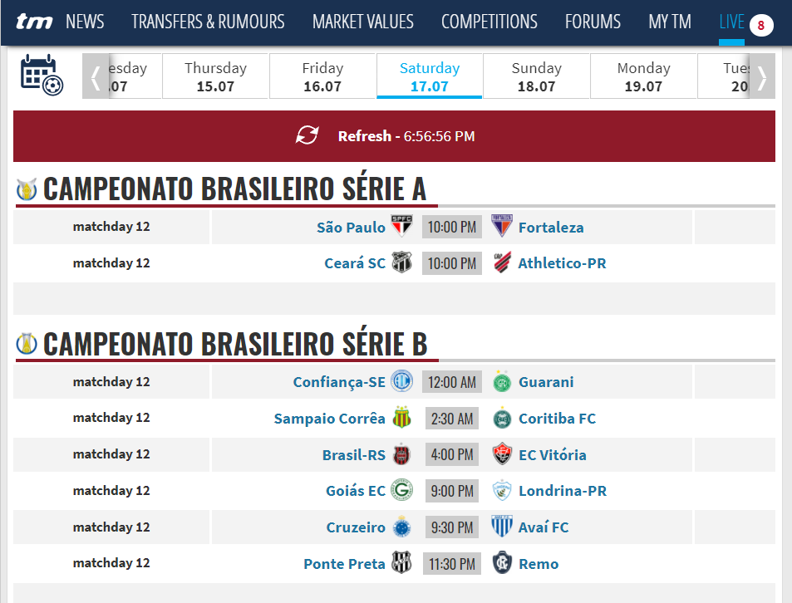
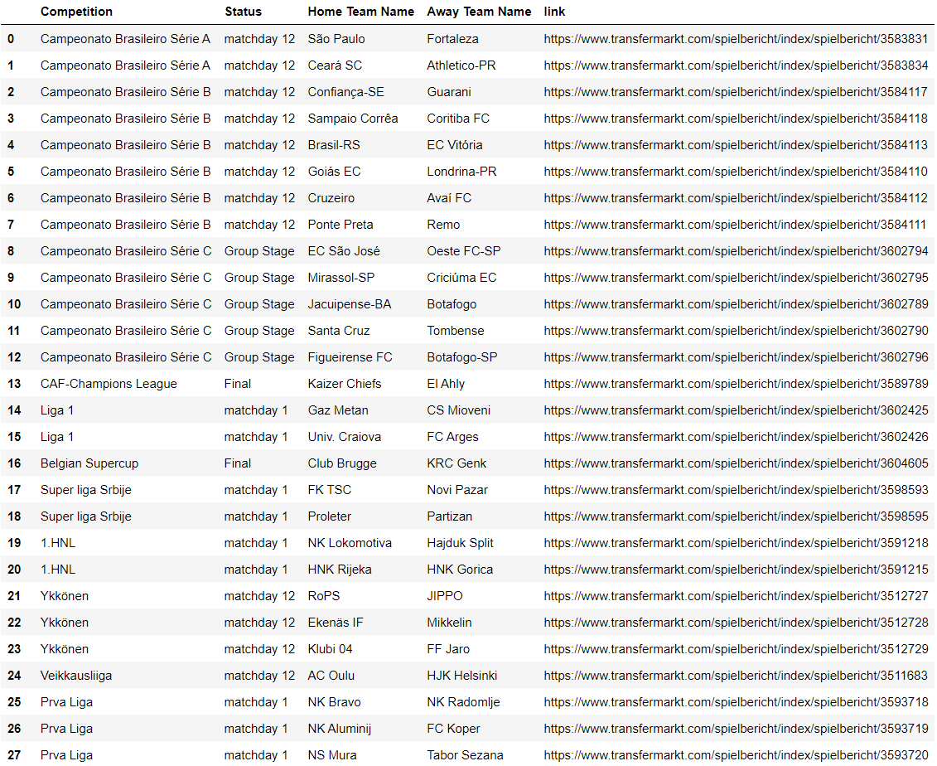
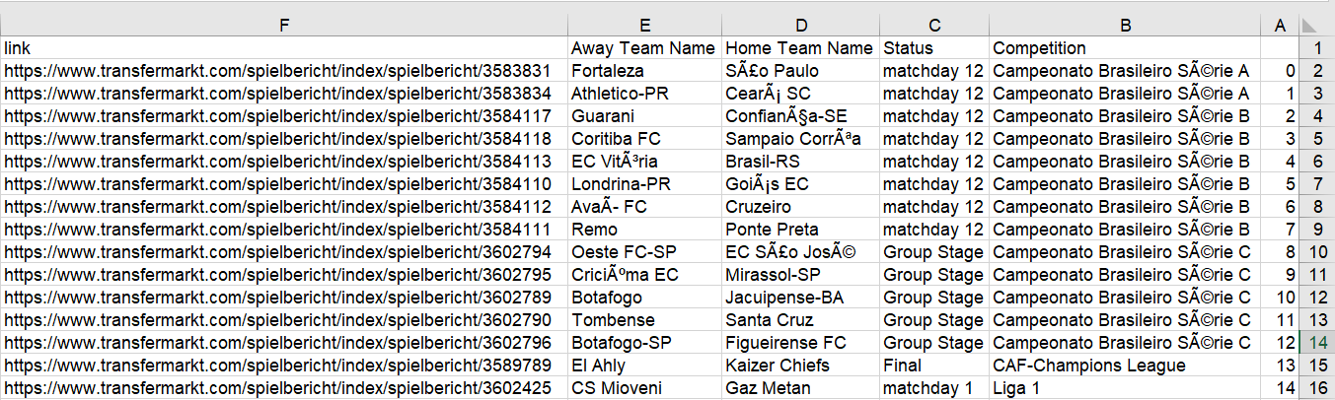
Data Collection – Web Crawling
Getting the chosen date games from the website and exporting them to a panda’s data frame. Exporting the data frame to a CSV file.

Slide 9
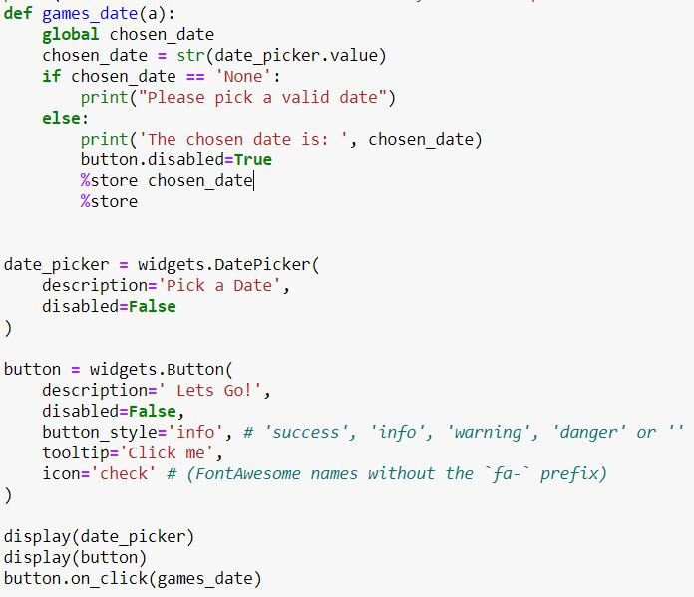
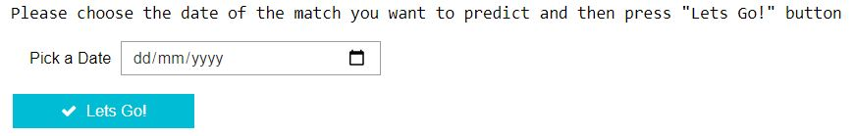
Data Collection – Date Picker
We used a “Date Picker” widget from ‘ipywidgets’ library for picking match date.
We used ‘ipython_blocking’ library to be able to use the data we received from the user's input into the date picker widget.

Slide 10
Stages Map
Model Deployment
06
ML Modeling
05
Data Visualization
04
You Are Here
Data Preparation
03
Data Collection
02
Problem Definition
01

Slide 11
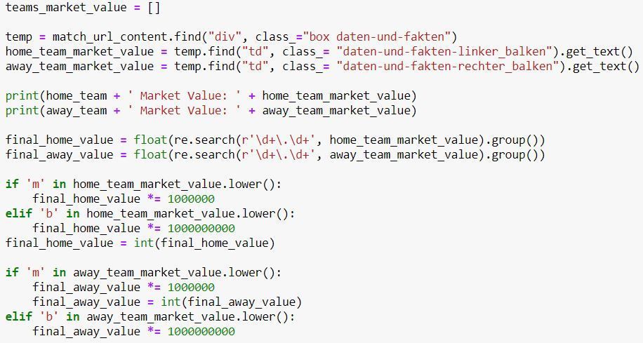
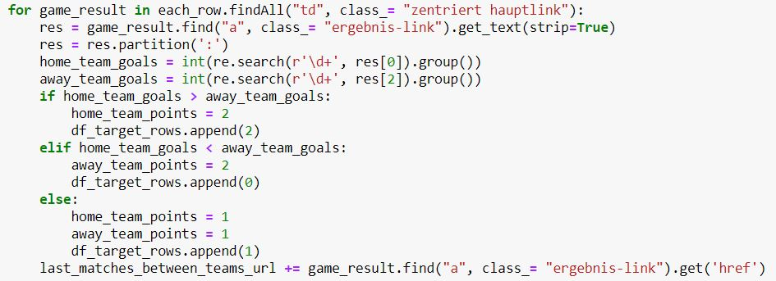
Data Preparation – formatting & cleansing
Formatting and cleansing the collected data so it can be used. We used ‘re’ library for that mission.
For example,
Converting the market values from 200m to 200000000
Converting the game result from 3:2 to 3 home team goals and 2 away team goals, what means that the home team won the match.

Slide 12
Stages Map
Model Deployment
06
ML Modeling
05
You Are Here
Data Visualization
04
Data Preparation
03
Data Collection
02
Problem Definition
01

Slide 13
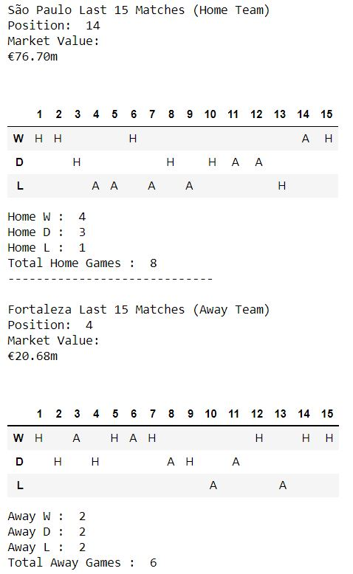
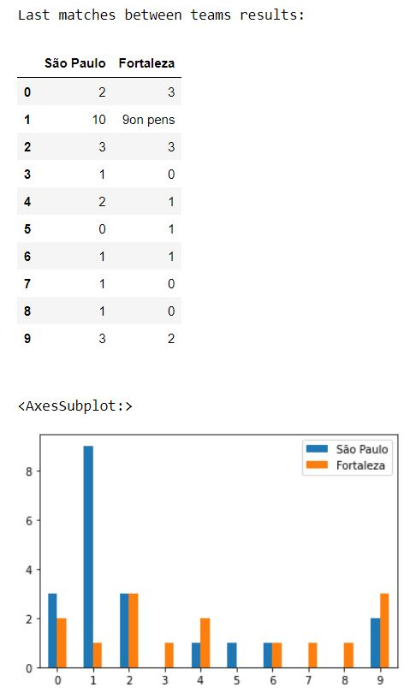
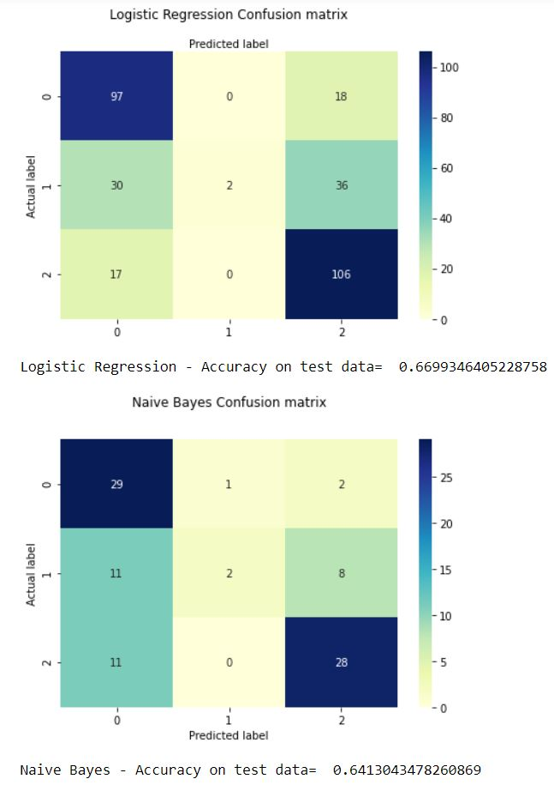
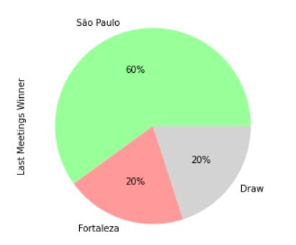
Data Visualization
We used ‘matplotlib’ library for that mission.

Slide 14
Stages Map
Model Deployment
06
ML Modeling
05
You Are Here
Data Visualization
04
Data Preparation
03
Data Collection
02
Problem Definition
01

Slide 15
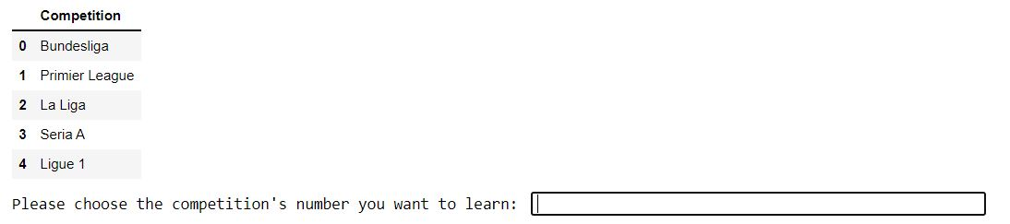
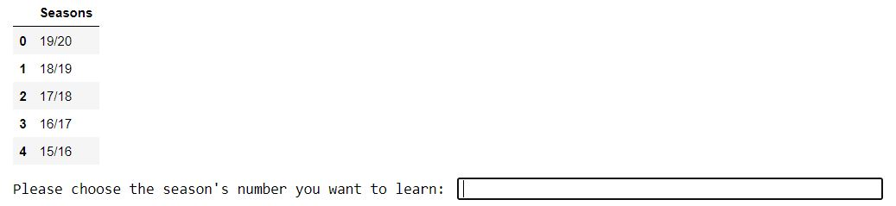
ML Modeling & Feature Engineering
In our project, the user can choose which league and season he wants to learn from.
The advantage of this method is that the user can choose to learn from the same league as his match, making the prediction even more accurate.

Slide 16
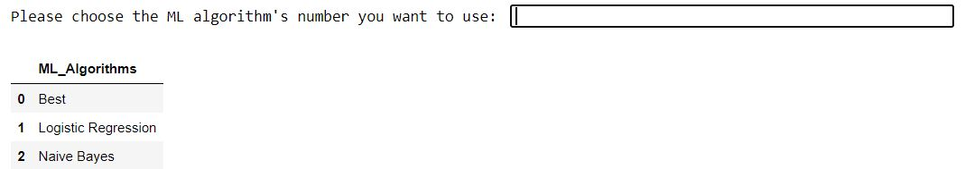
ML Modeling & Feature Engineering
Choosing the ML model
After collecting the necessary data about the chosen league and season, we used `sklearn` library to be able to train a model that predicts the probability of each results of the selected league's matches. Our predictions will be the results with the highest probability.
The user can choose which algorithms he wants to use:
Best – the most accurate algorithm.
Logistic Regression
Naive Bayes

Slide 17
ML Modeling & Feature Engineering
Positions
01
The team ranked higher in the league table has a better chance of winning.
Recent matches results
02
The team that did better results in her last matches has a better chance of winning.
Past meetings results
03
The team that did better results in their previous meetings has a better chance of winning.
Players Strengths
04
The team with the better players has a better chance of winning. Bigger market value indicates on a better players.

Slide 18
Stages Map
You Are Here
Model Deployment
06
ML Modeling
05
Data Visualization
04
Data Preparation
03
Data Collection
02
Problem Definition
01

Slide 19
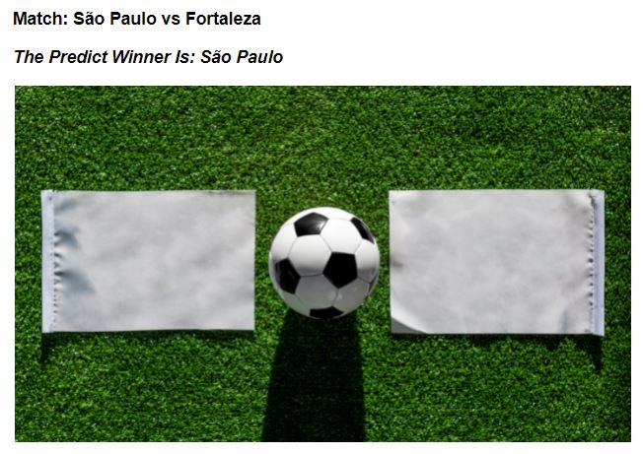
Model Deployment
The final prediction
This is the last step of the machine learning process.
The model is now ready to make predictions on his own, based on the relevant match data.
All we have is to choose the match we want to predict and our model will do the rest.

Slide 20
Model Deployment
Home Team
0
SOCCER
0
Away Team
Home Team |  | Away Team
Market Value | Vs | Market Value
Position | Content Here | Position
Past home meetings between teams results | Text | Past away meetings between teams results
Recent home matches results | Content Here | Recent away matches result
Match points | Text | Match points

Slide 21


Thank You.

